Slide 1

Visión por Computador
Domingo Mery
Departamento de Ciencia de la Computación
Escuela de Ingeniería
Universidad Católica de Chile
GAN

Slide 2
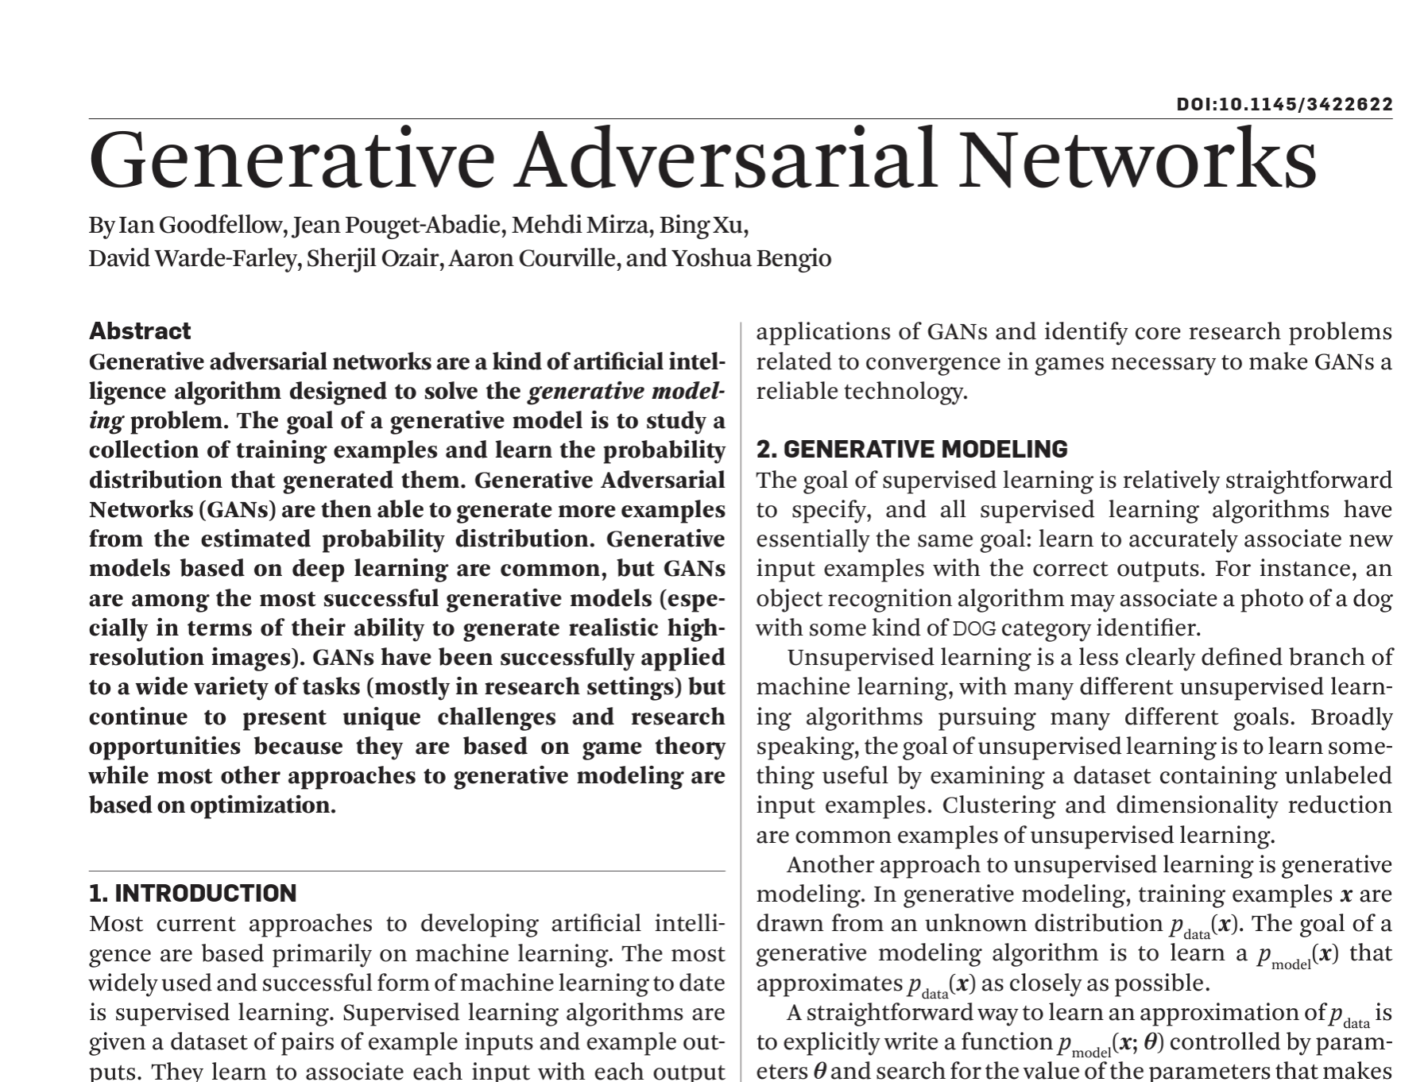

Slide 3
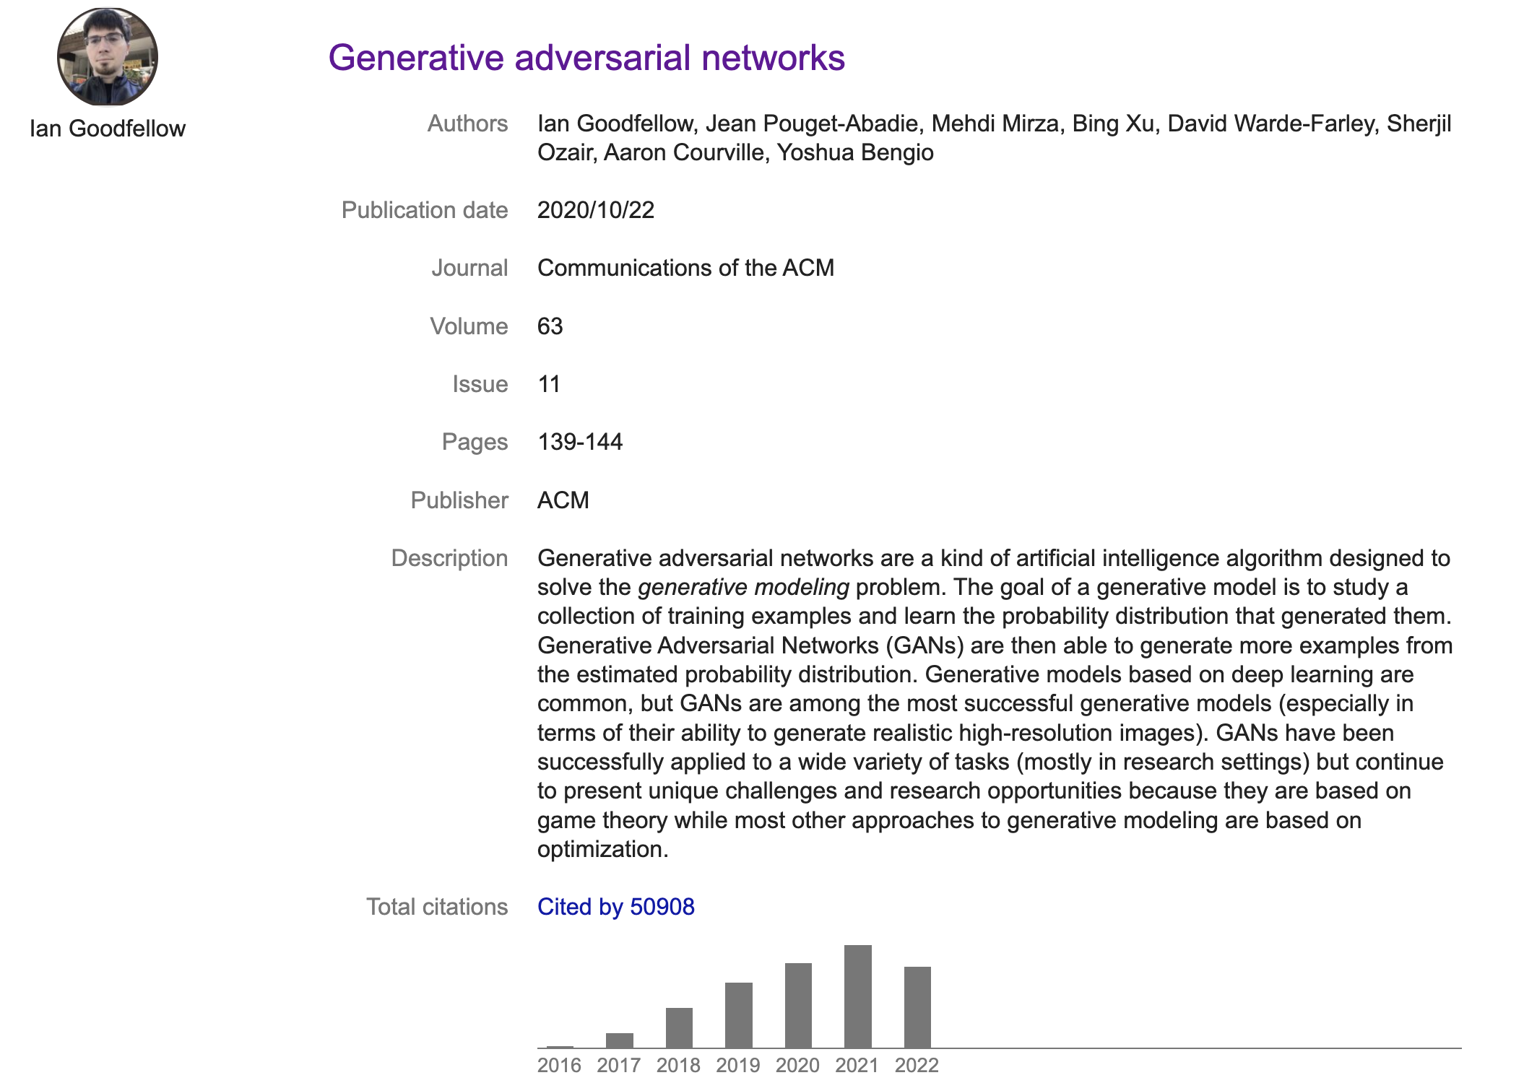

Slide 4

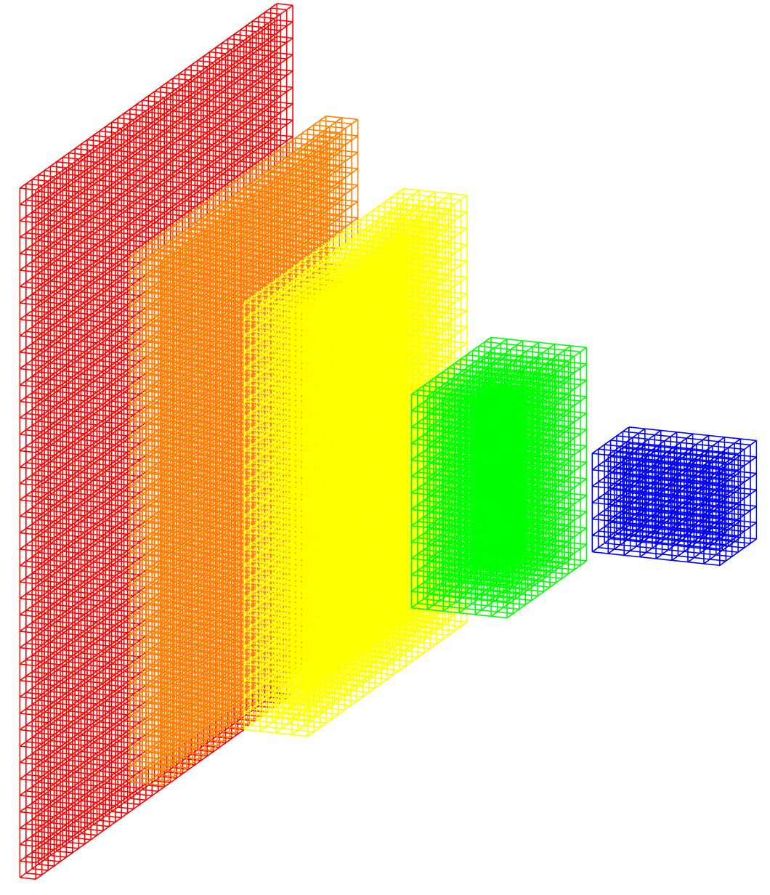
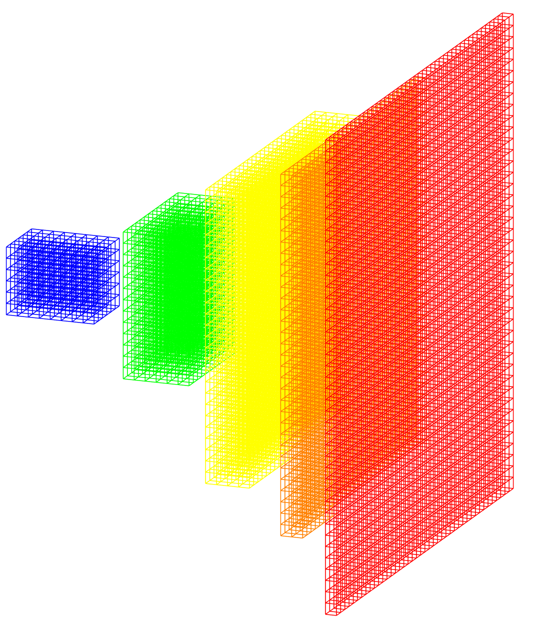
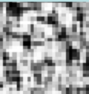
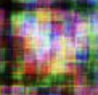
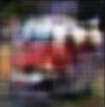
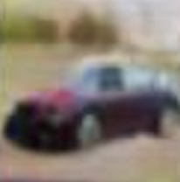
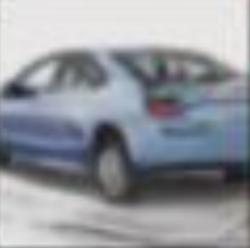
GAN: Generative Adversarial Network
Ground truth: real/fake
Real image
Discriminator
real/fake
Generator
error
Noise
Fake image
Iter = 1 500 10,000 50,000
error
Notes:
Zero-sum game theory

Slide 5
GAN: Generative Adversarial Network
Ground truth: real/fake
Real image
Discriminator
real/fake
Generator
error
Noise
Fake image
Iter = 1 500 10,000 50,000
error
Notes:
Zero-sum game theory

Slide 6
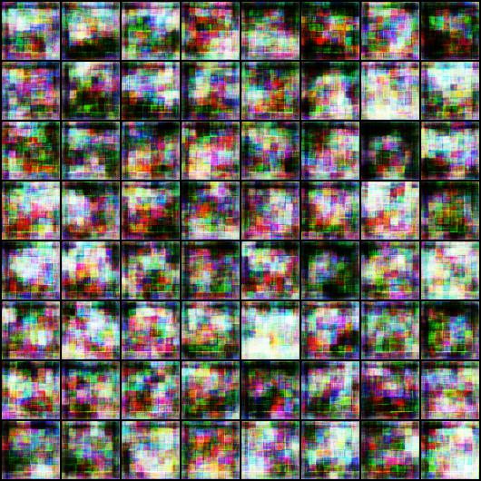
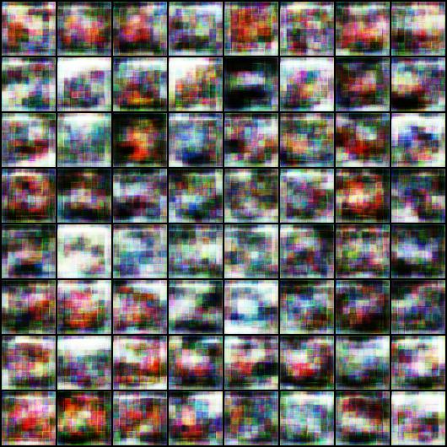
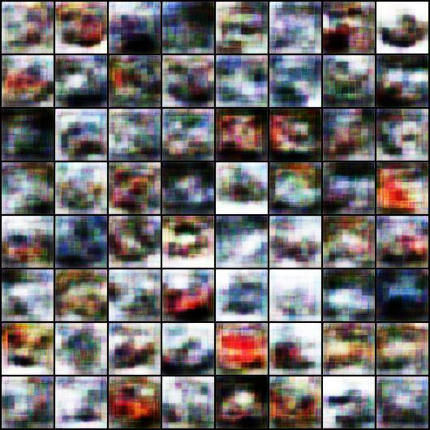
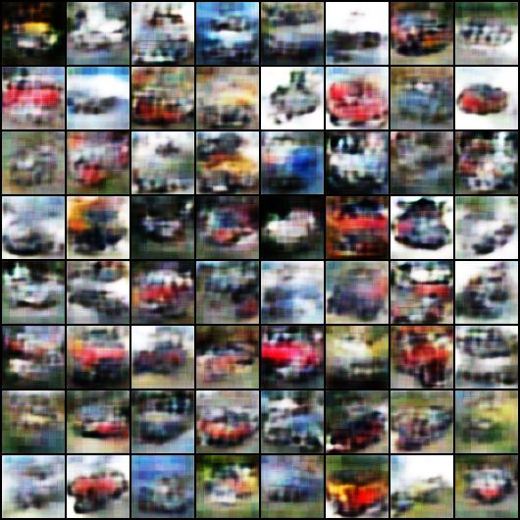
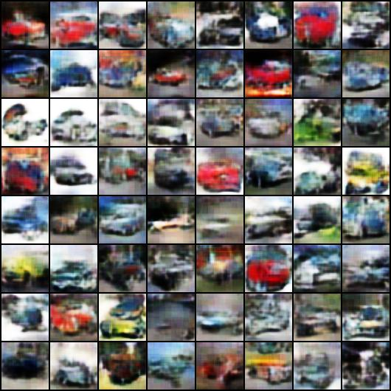
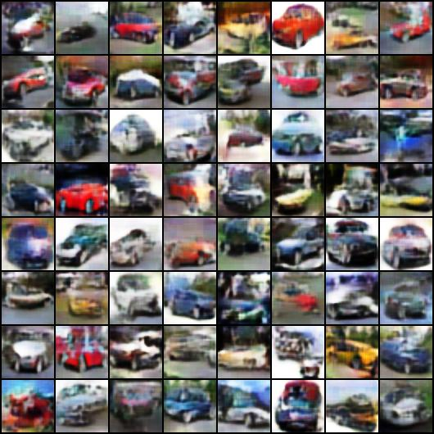
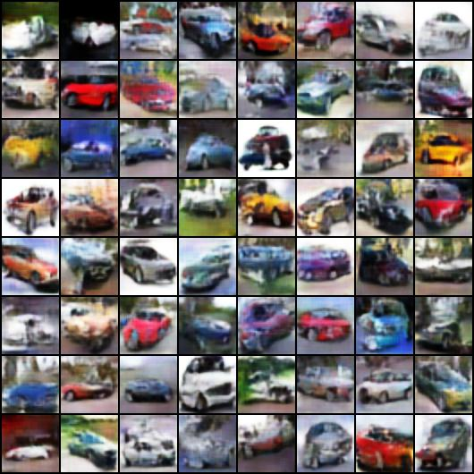
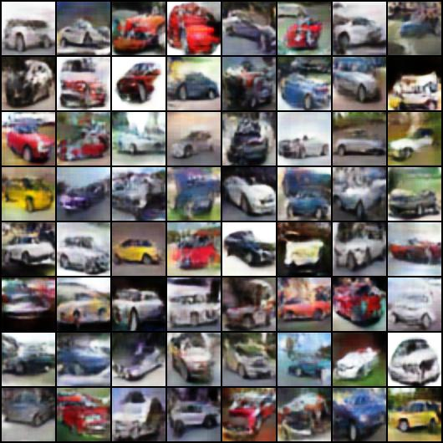
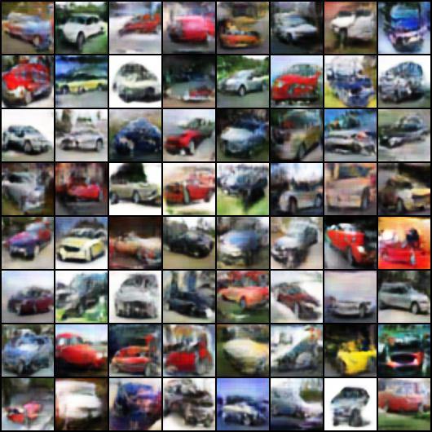
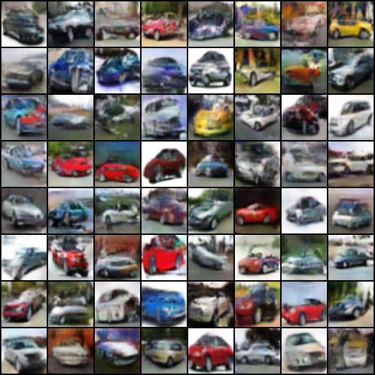
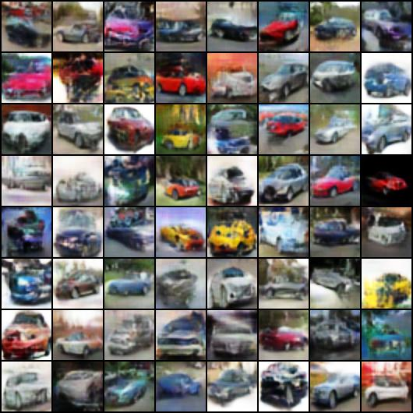
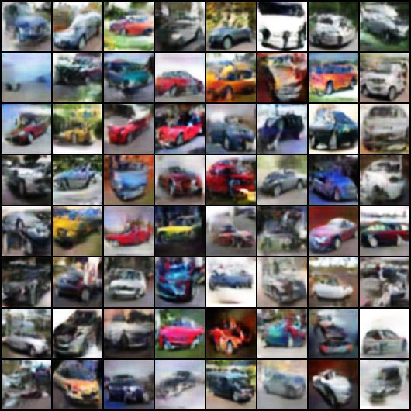
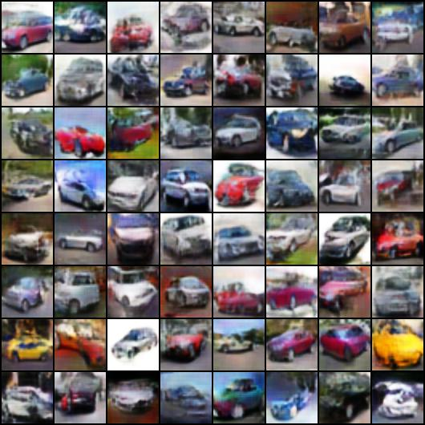
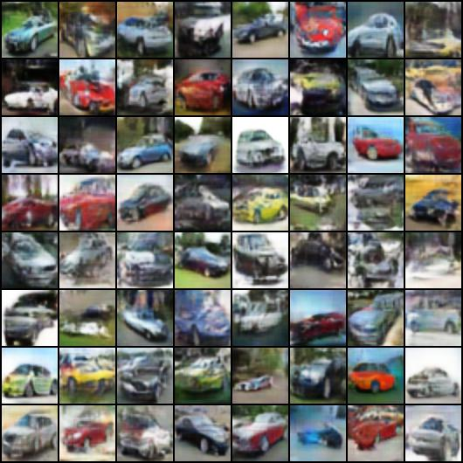
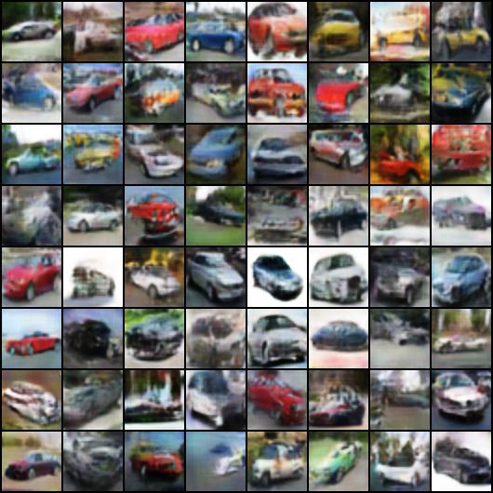
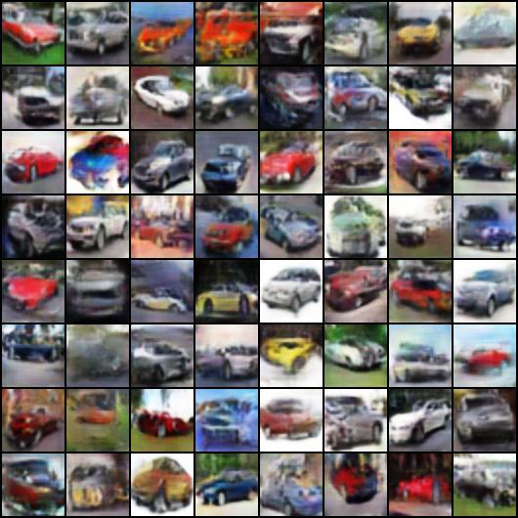
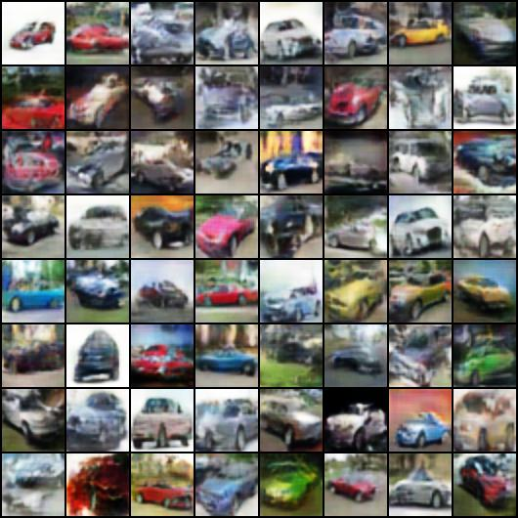
20
100
5000
13000
Notes:
-rw-r--r--@ 1 domingomery staff 94169 15 Jul 22:43 00020.jpg
-rw-r--r--@ 1 domingomery staff 80863 15 Jul 22:42 00040.jpg
-rw-r--r--@ 1 domingomery staff 67402 15 Jul 22:42 00100.jpg
-rw-r--r--@ 1 domingomery staff 62770 15 Jul 22:42 00500.jpg
-rw-r--r--@ 1 domingomery staff 59893 15 Jul 22:42 01000.jpg
-rw-r--r--@ 1 domingomery staff 61521 15 Jul 22:41 02000.jpg
-rw-r--r--@ 1 domingomery staff 60250 15 Jul 22:41 03000.jpg
-rw-r--r--@ 1 domingomery staff 59664 15 Jul 22:41 04000.jpg
-rw-r--r--@ 1 domingomery staff 59934 15 Jul 22:40 05000.jpg
-rw-r--r--@ 1 domingomery staff 58940 15 Jul 22:40 06000.jpg
-rw-r--r--@ 1 domingomery staff 58243 15 Jul 22:40 07000.jpg
-rw-r--r--@ 1 domingomery staff 59878 15 Jul 22:40 08000.jpg
-rw-r--r--@ 1 domingomery staff 58025 15 Jul 22:40 09000.jpg
-rw-r--r--@ 1 domingomery staff 57869 15 Jul 22:42 10000.jpg
-rw-r--r--@ 1 domingomery staff 57937 15 Jul 22:42 11000.jpg
-rw-r--r--@ 1 domingomery staff 58064 15 Jul 22:41 12000.jpg
-rw-r--r--@ 1 domingomery staff 58081 15 Jul 22:41 13000.jpg

Slide 7
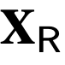
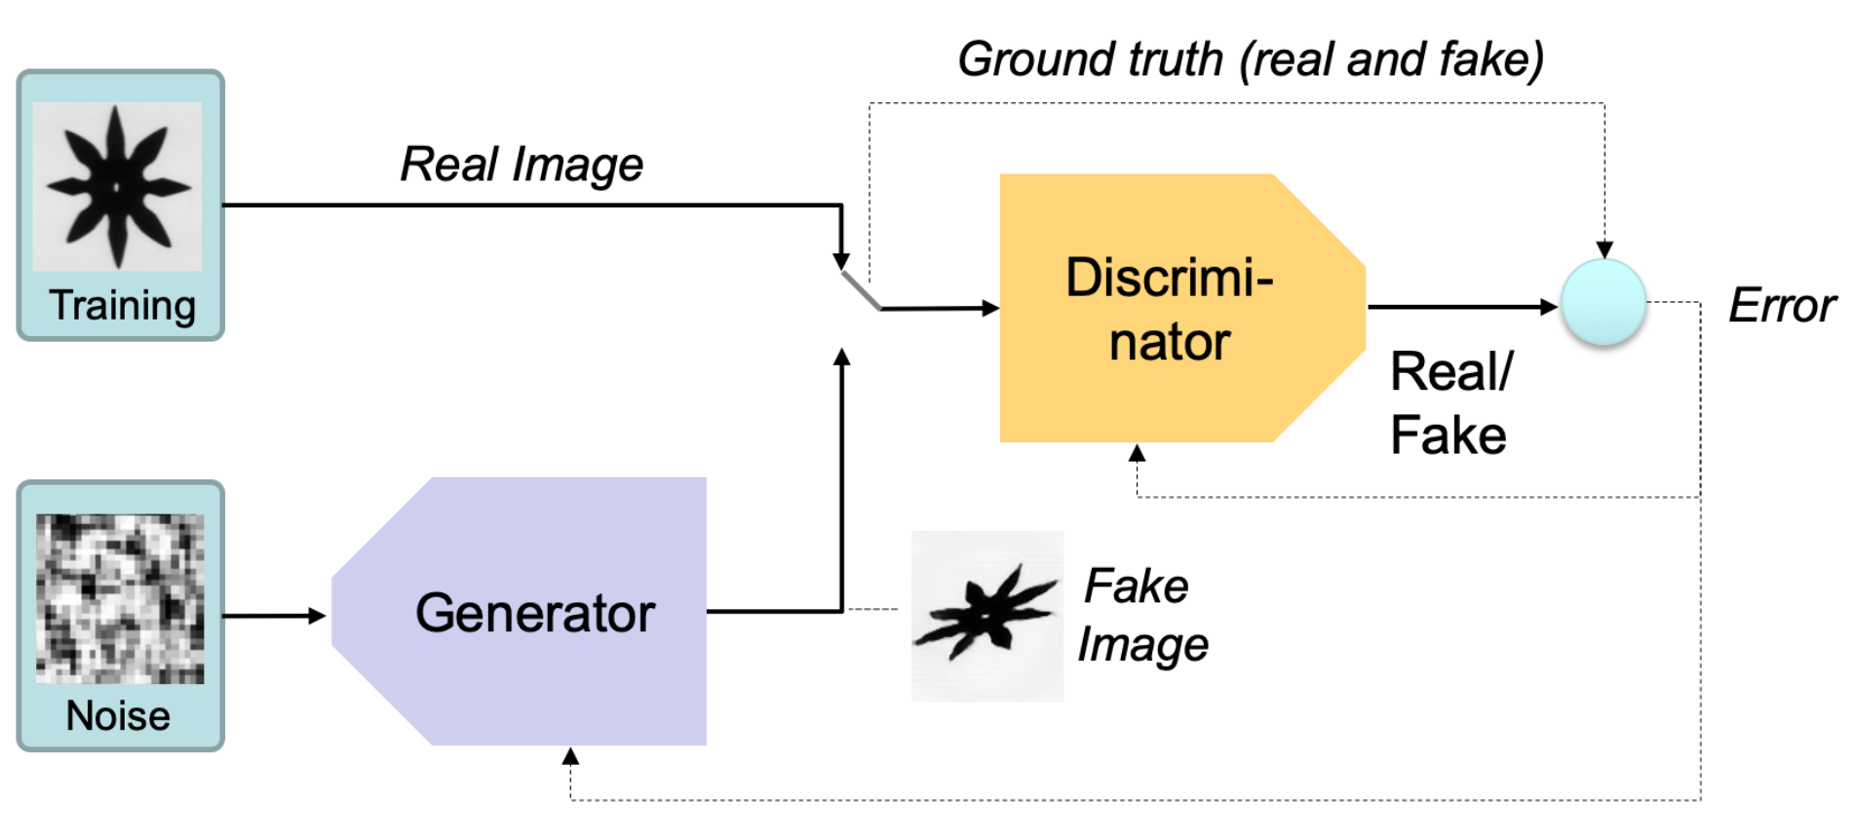
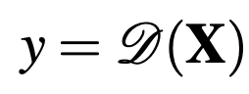
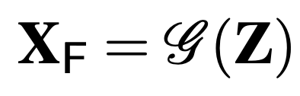
y
Z

Slide 8
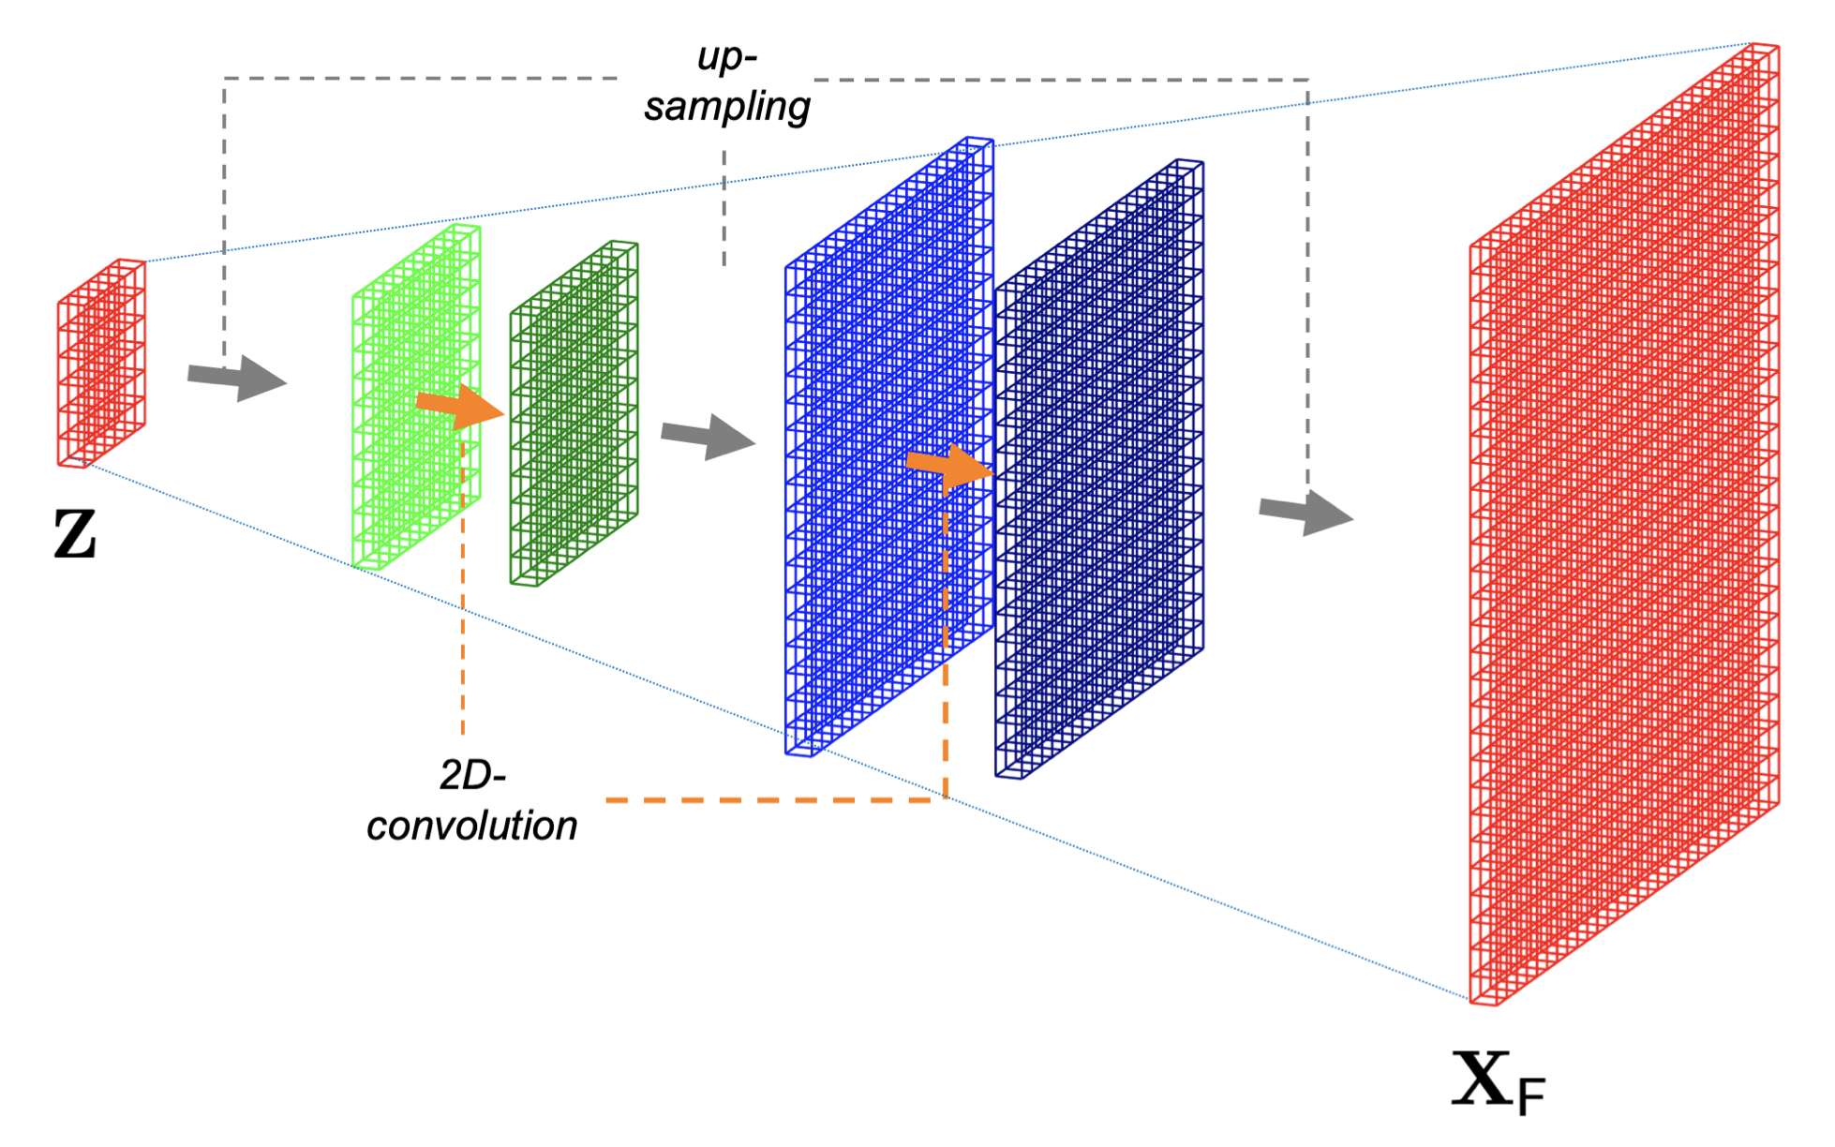

Slide 9
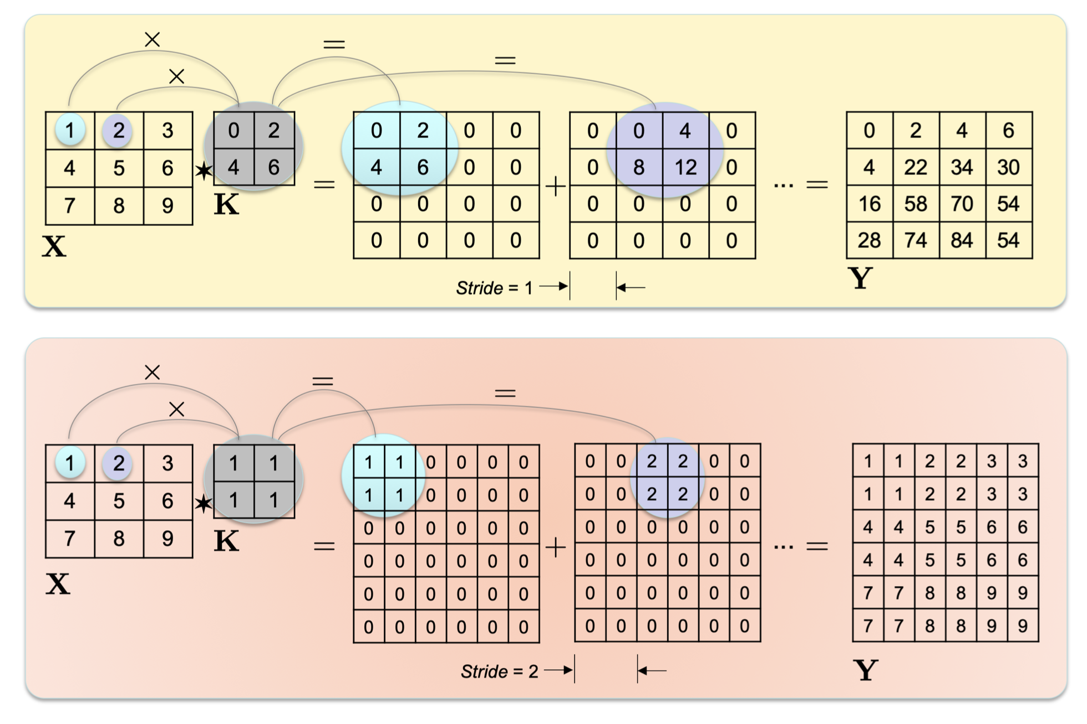

Slide 10
1: real
0: fake
y
Z

Slide 11
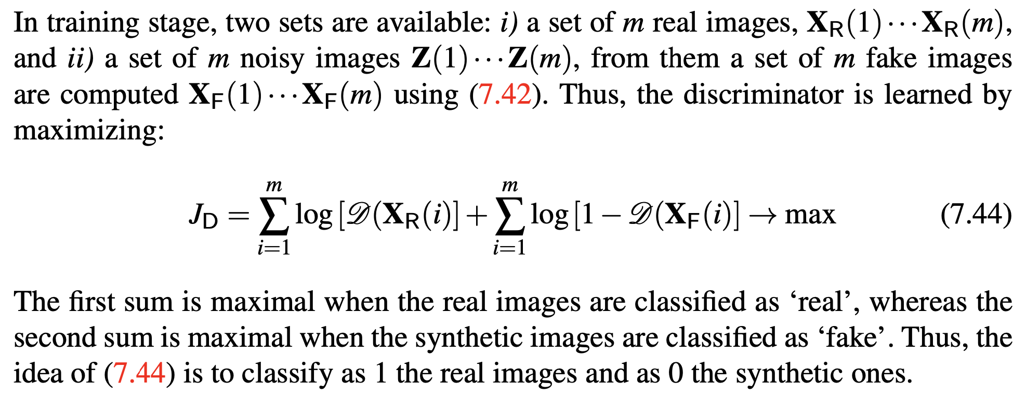

Slide 12
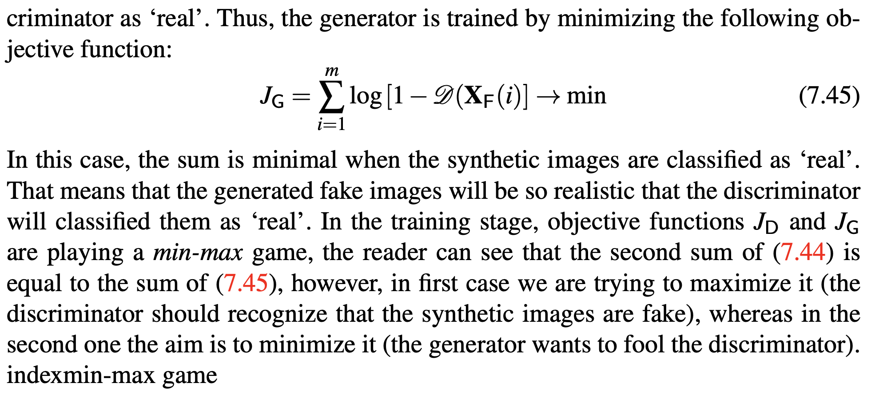

Slide 13
1: real
0: fake
y
Z

Slide 14
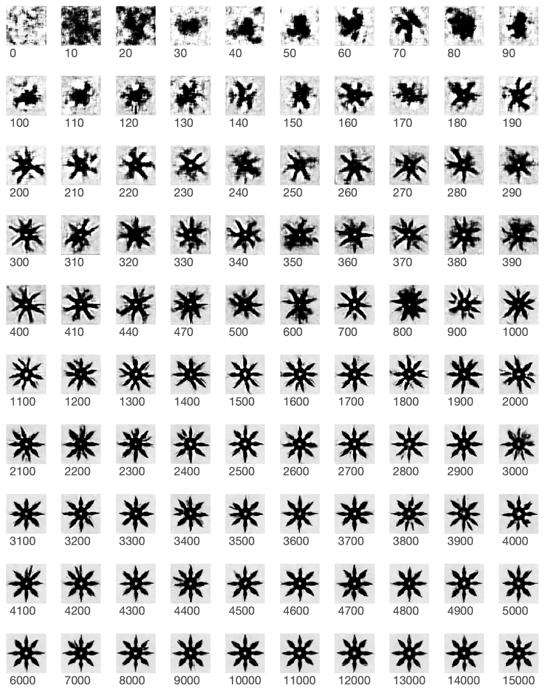
GAN: Shuriken

Slide 15
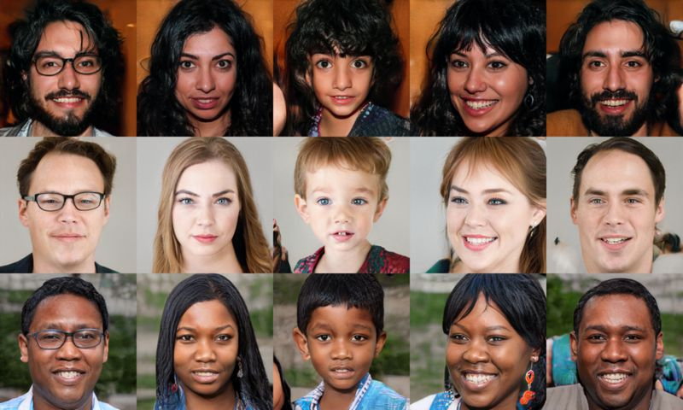
www.ThisPearsonDoesNotExist.com

Slide 16
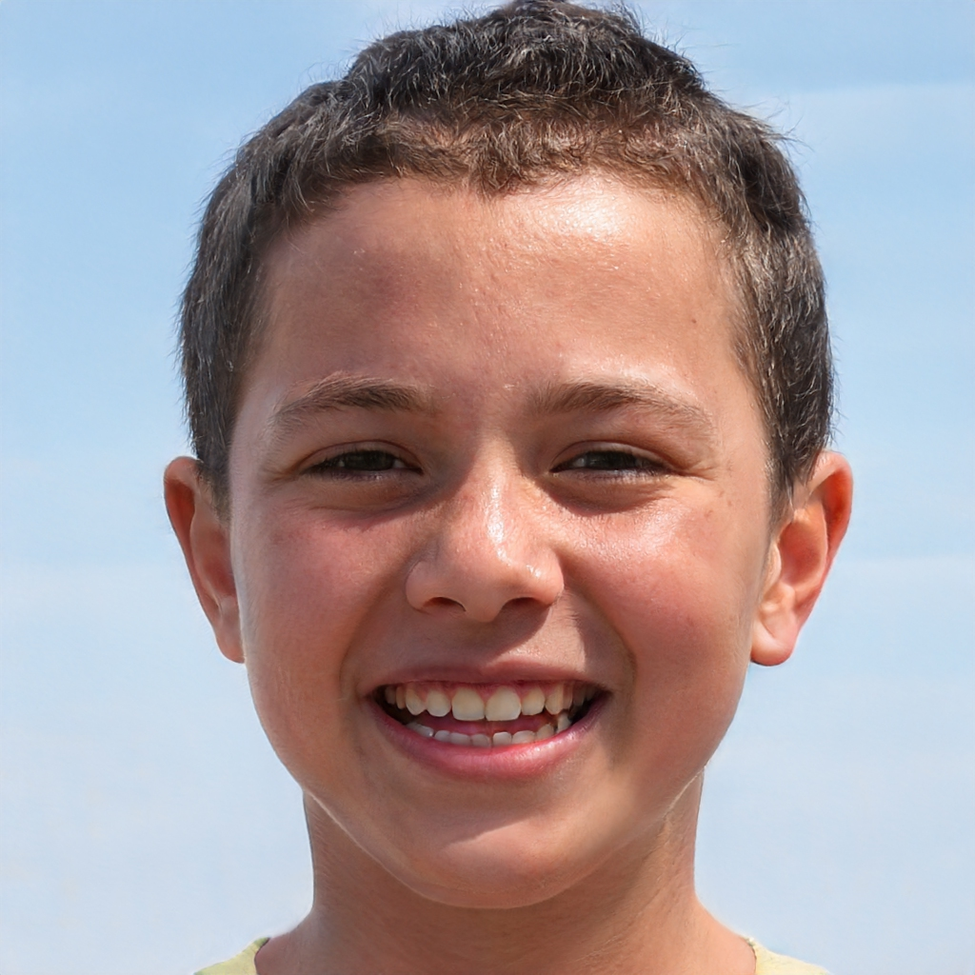

Slide 17
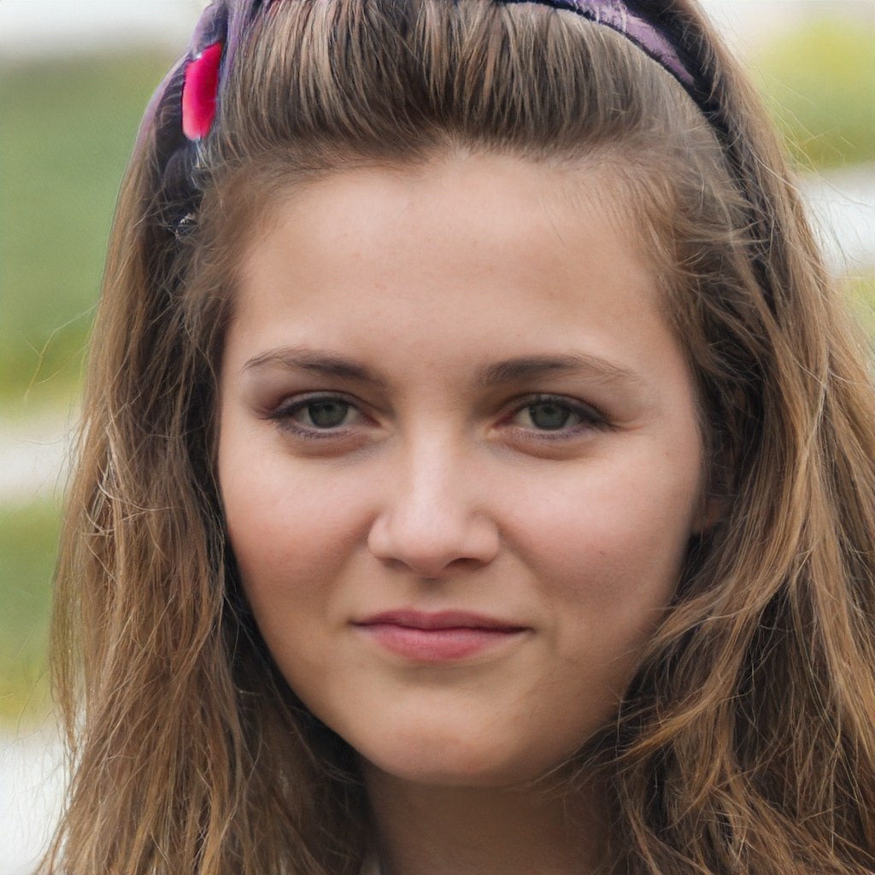

Slide 18
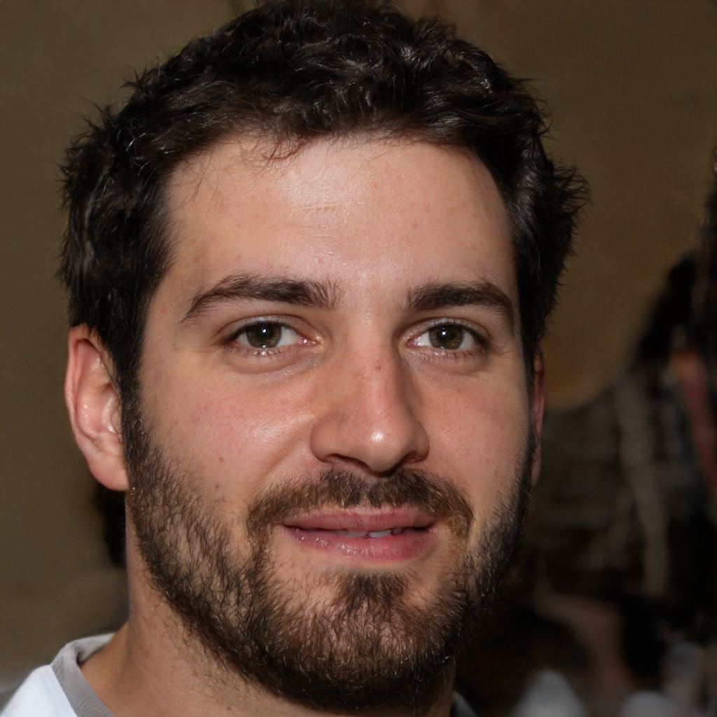

Slide 19
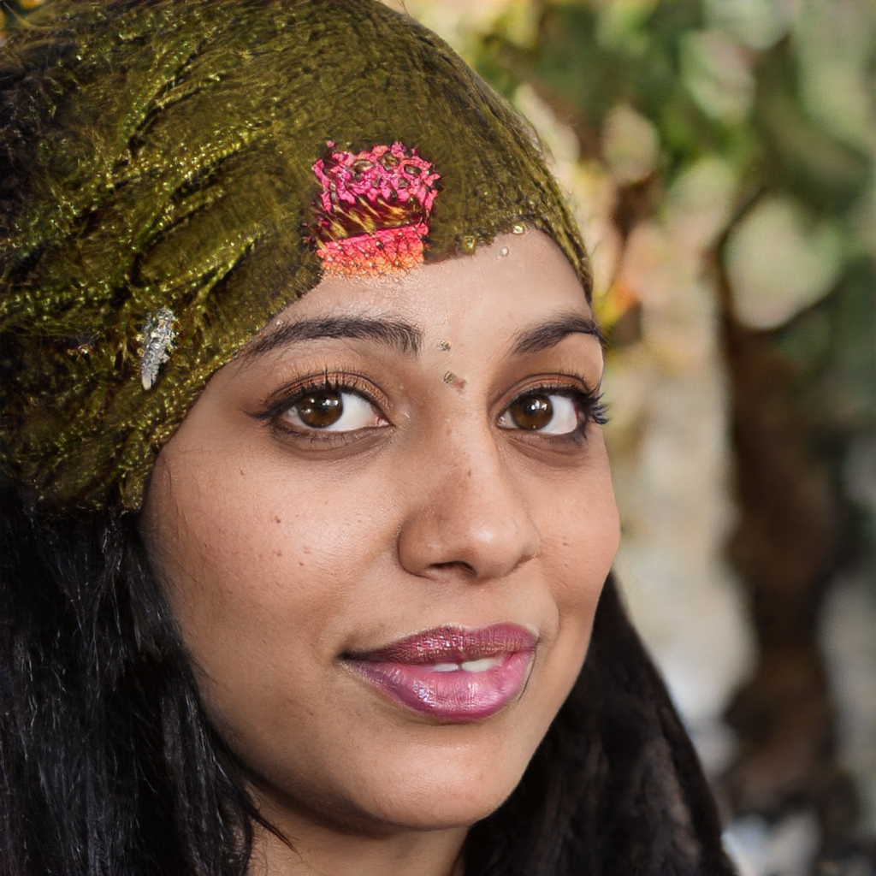

Slide 20
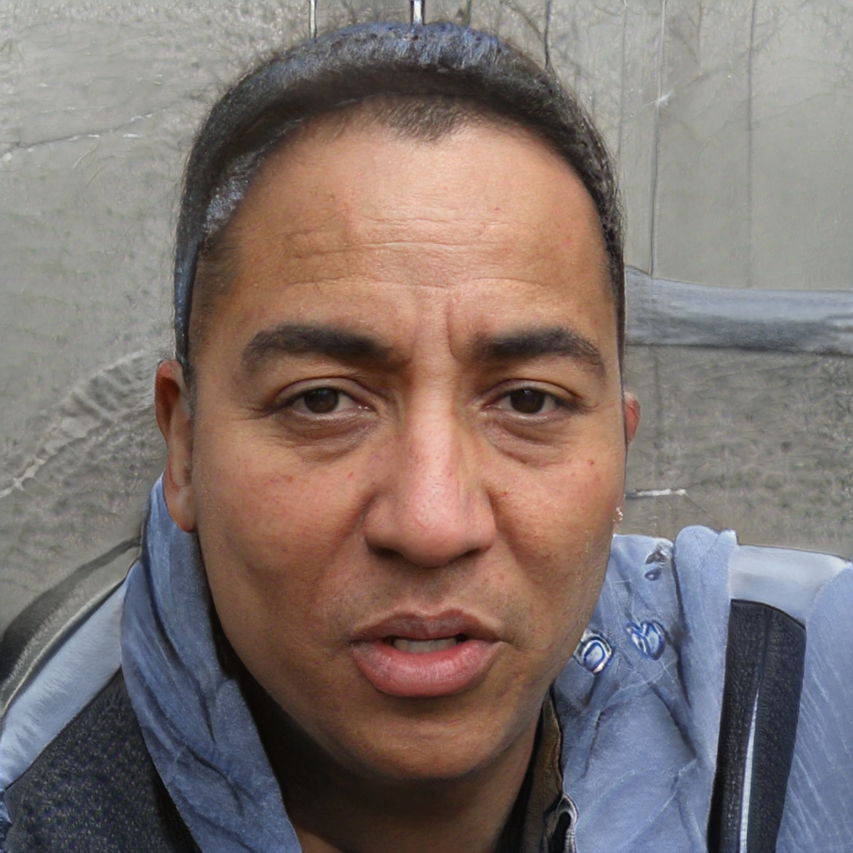

Slide 21
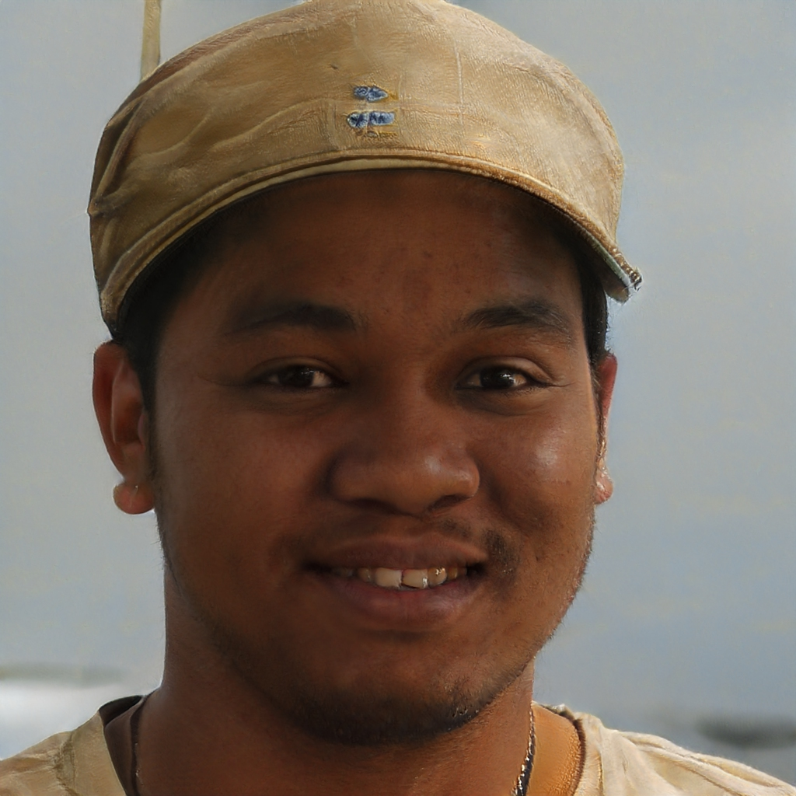

Slide 22
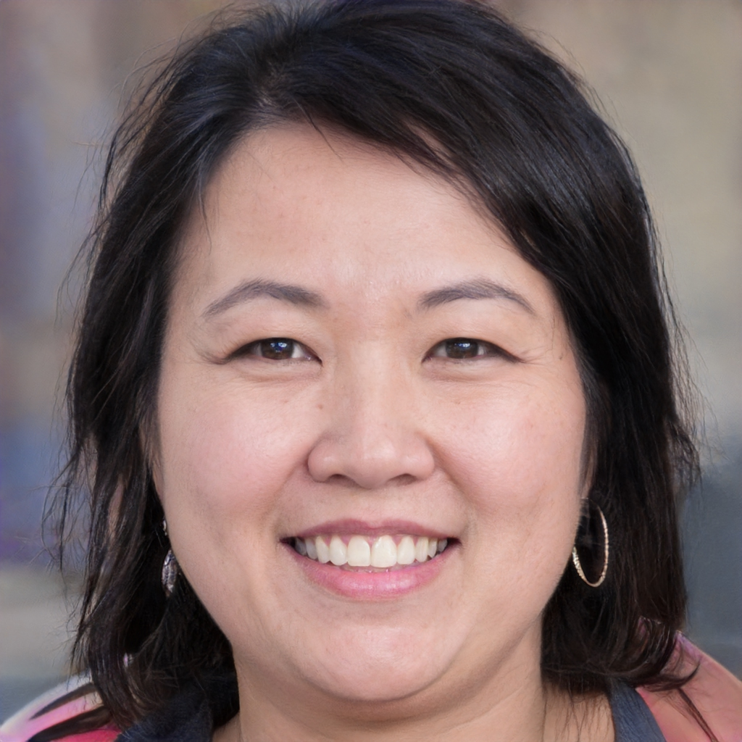

Slide 23
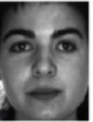
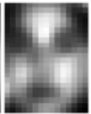
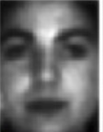
GAN para Super-Resolution
1: real
0: fake
y
Hi-Resolution
Low-Resolution
Z

Slide 24
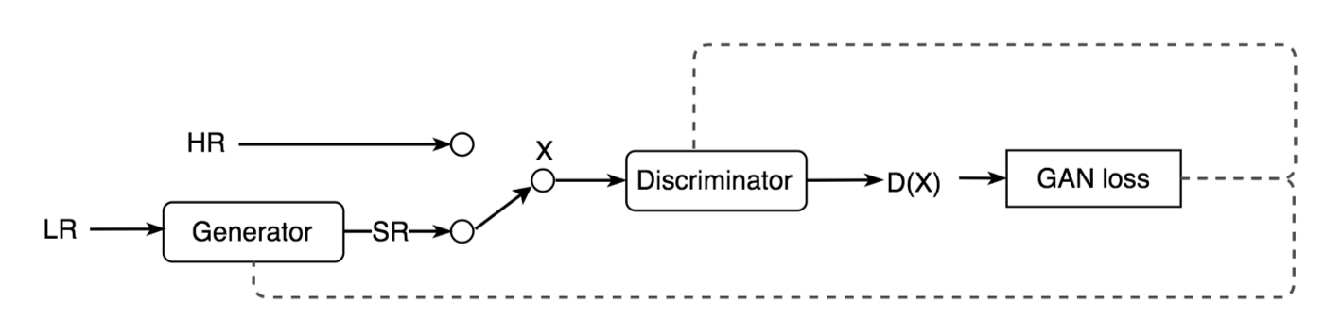
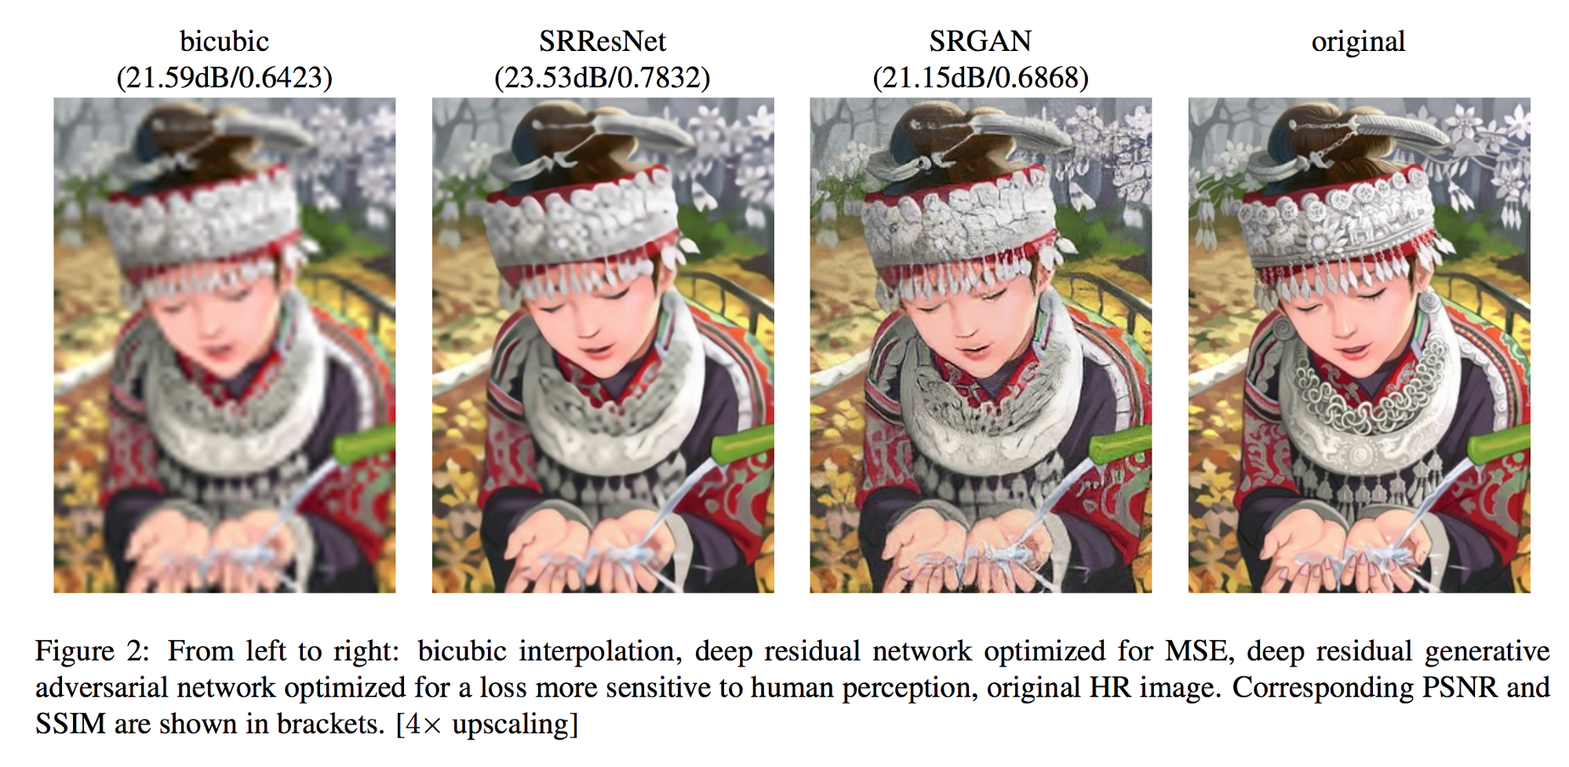

Slide 25
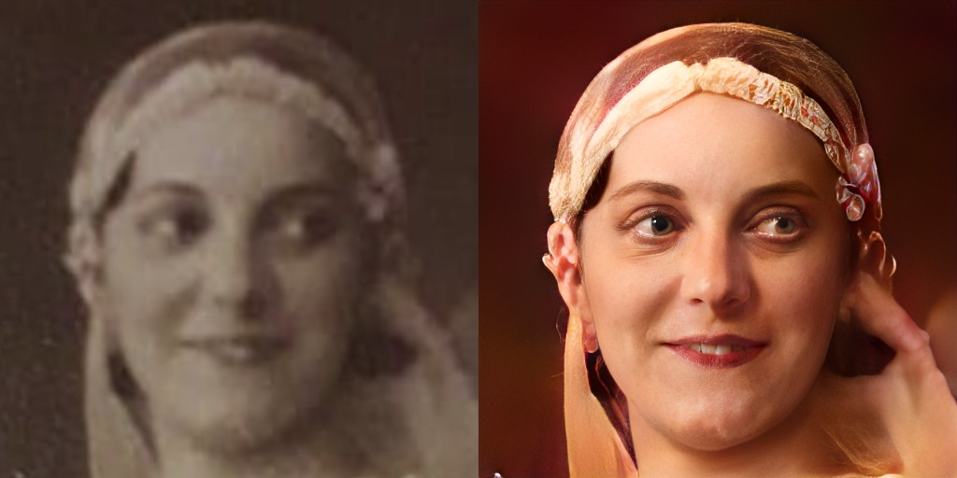

Slide 26
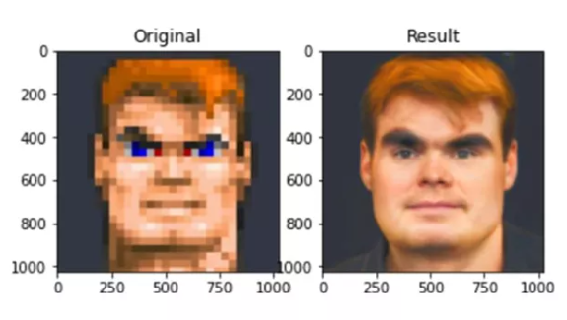

Slide 27
Algunos problemas...

Slide 28


Slide 29



Slide 30

https://syncedreview.com/2019/02/09/nvidia-open-sources-hyper-realistic-face-generator-stylegan/

Slide 31

https://syncedreview.com/2019/02/09/nvidia-open-sources-hyper-realistic-face-generator-stylegan/

Slide 32

8. GAN / Deep Fakes
FakeApp: ¿cómo hacer un DeepFake y cómo funciona la app? - Cultura Geek

Slide 33

8 steps to verify Deep Fake videos | by Konrad Weber | Medium

Slide 34

Notes:
Hi Domingo, this is a quick video to say hello to your students

